Slide 1

Business Analytics II (BIS 244 – Chapter 1)
BIS 244 – Fall 2022 – Dr. Davoodi

Slide 2

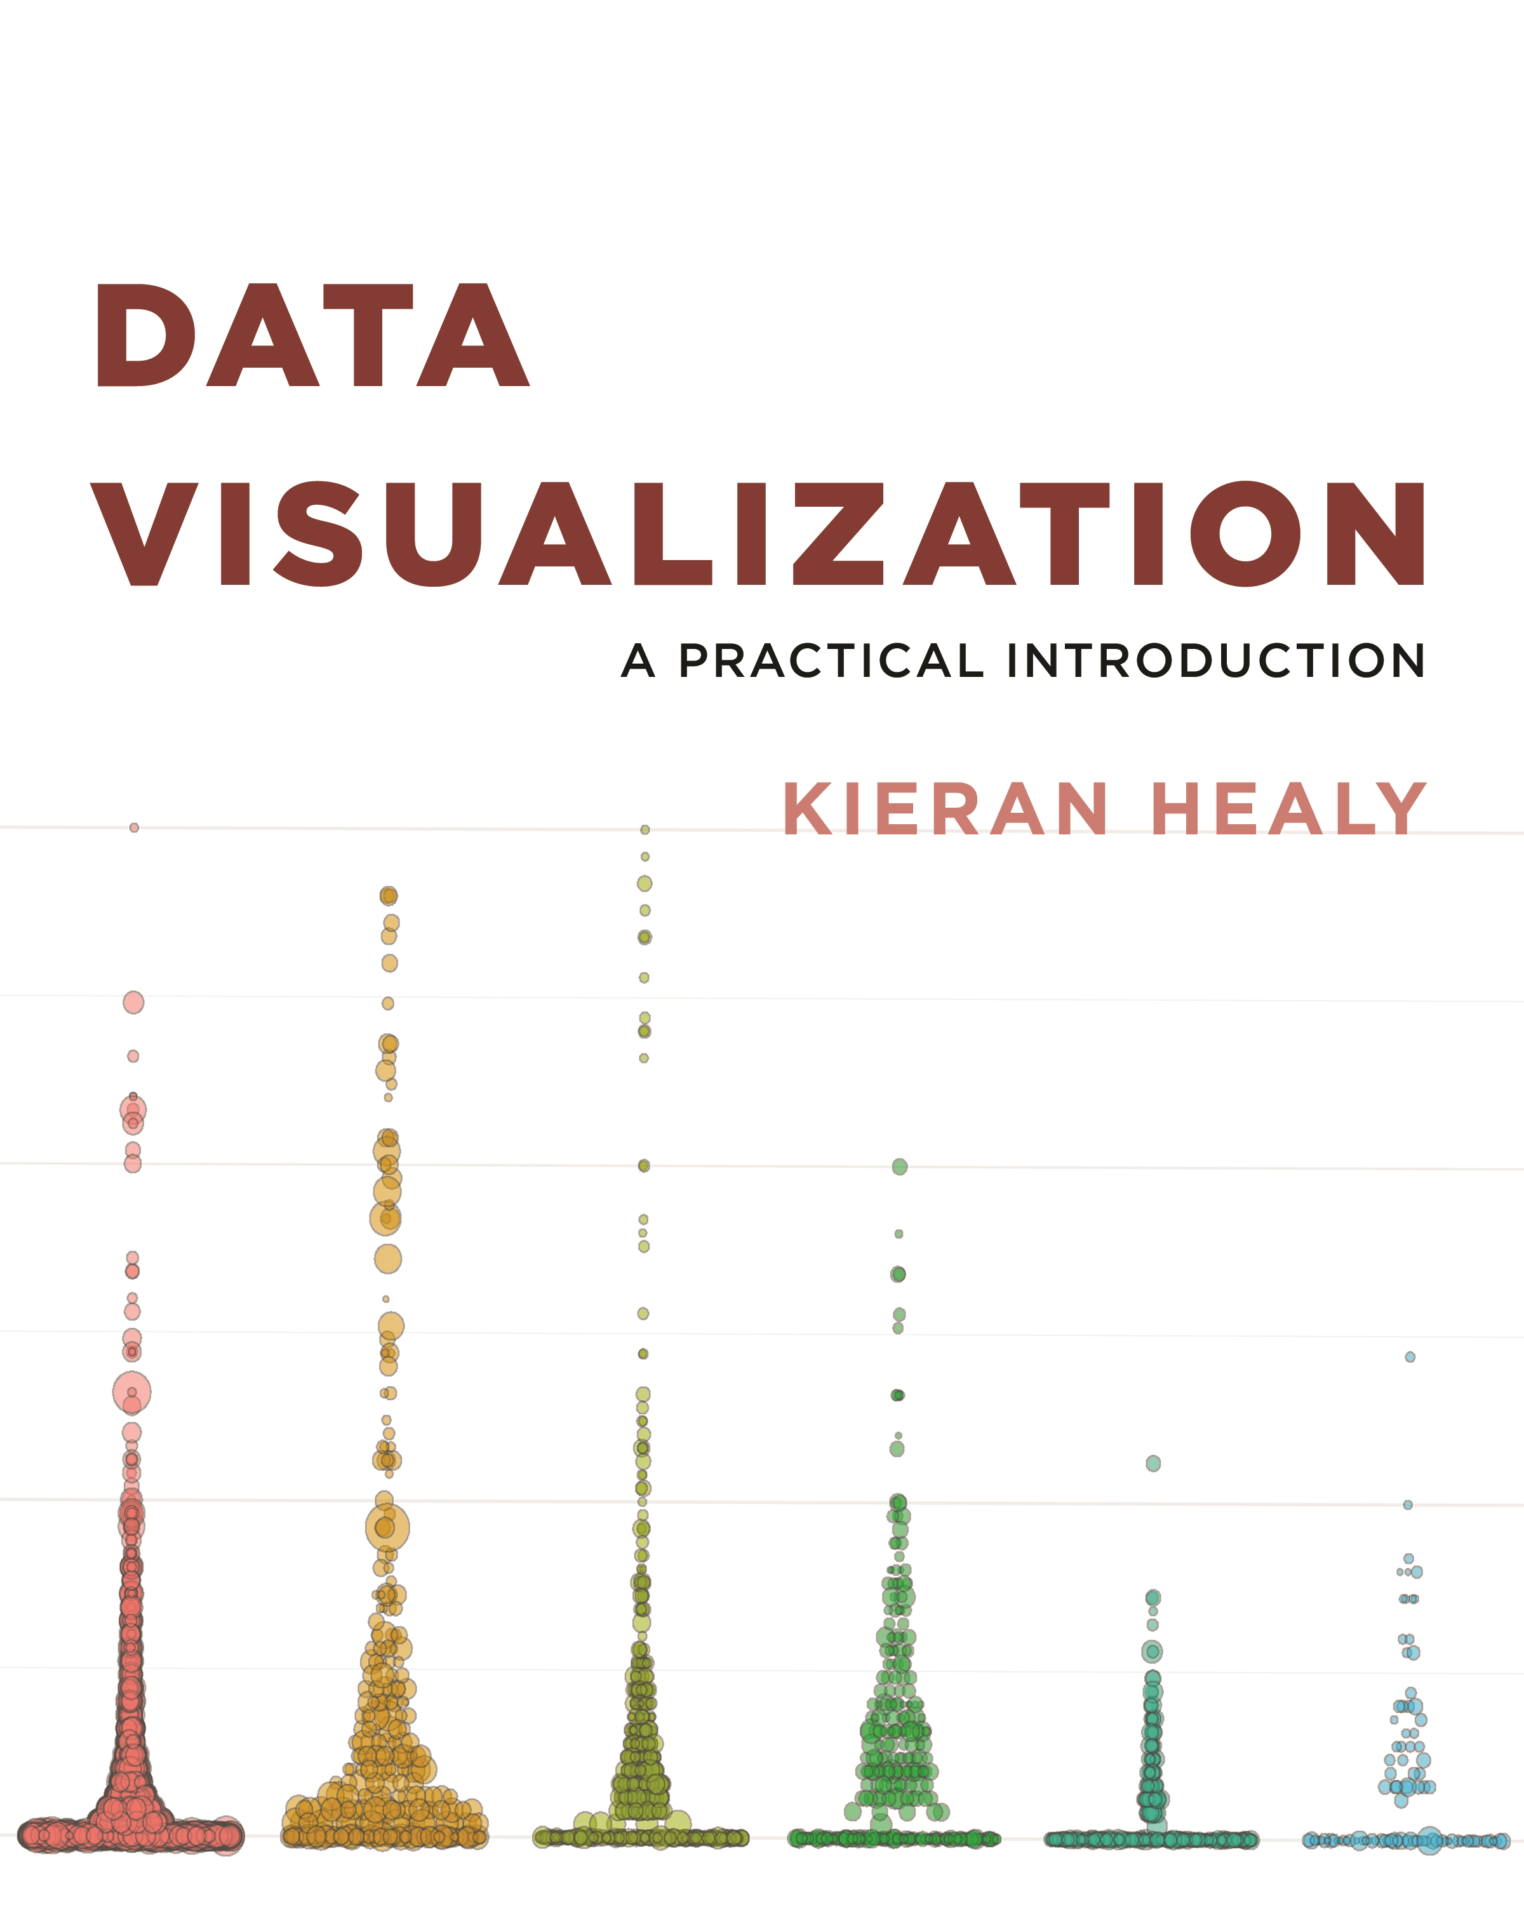
Chapter 1: Look at Data

Slide 3
Chapter 1: Look at Data
1.1 Why Look at Data?
1.2 What Makes Bad Figures Bad?
1.3 Perception and Data Visualization
1.4 Visual Tasks and Decoding Graphs
1.5 Channels for Representing Data
1.6 Problems of Honesty and Good Judgment
1.7 Think Clearly about Graphs

Slide 4
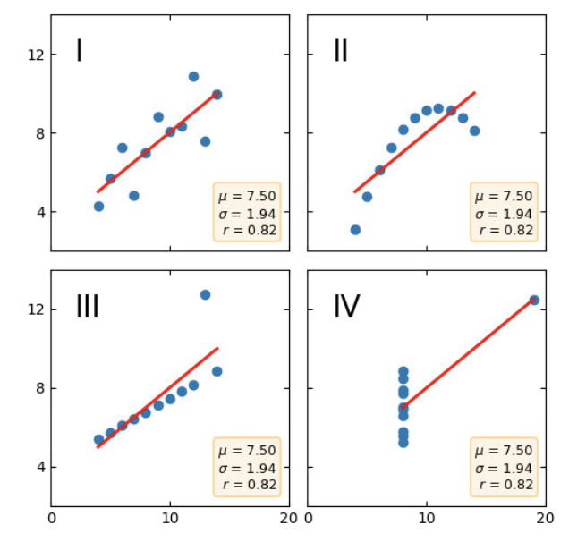
1.1 - Why Look at Data?
We will begin by asking why we should bother to look at pictures of data in the first place, instead of relying on tables or numerical summaries.
In Statistics courses, you learn how to calculate some measures, ratios, and statistics, such as:
Mean (μ)
Standard deviation (σ)
Median
Mode
Correlation coefficient (r)
Figure 1.1: Plots of Anscombe’s quartet

Slide 5
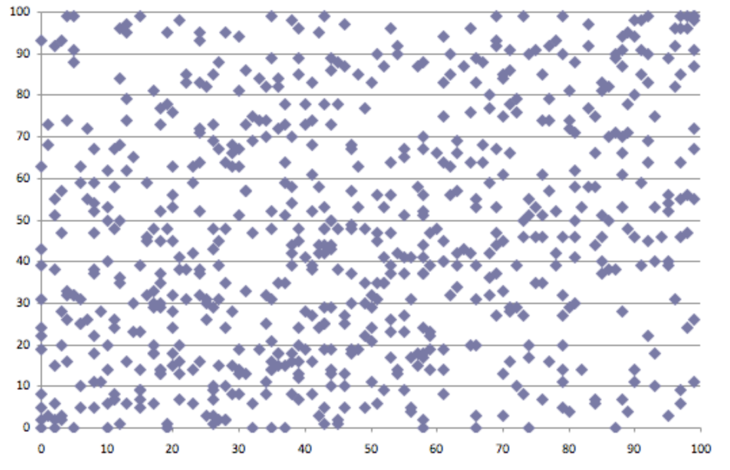
1.1 - Why Look at Data?
Illustrations like Anscombe’s quartet demonstrate why it is worth looking at data.
But that does not mean that looking at data is all one needs to do, and we will not automatically get the right answer to our questions just by looking.
Data summarization
Data visualization
Real datasets are messy, and while displaying them graphically is very useful, doing so presents problems of its own.

Slide 6
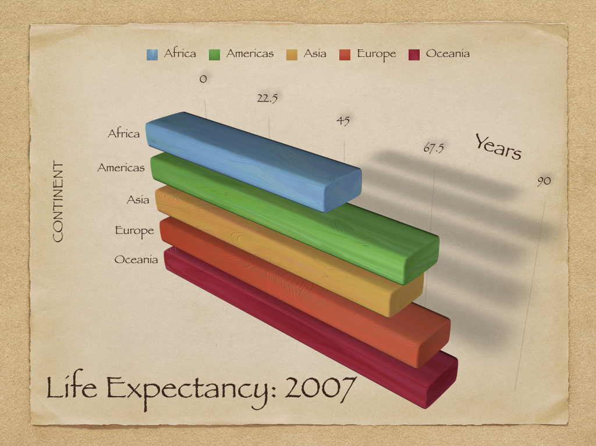
1.2 - What Makes Bad Figures Bad?
Bad taste & chart junk!
The bars are hard to read and compare,
It needlessly duplicates labels,
pointless uses of three-dimensional effects,
drop shadows, and
other unnecessary design features.

Slide 7
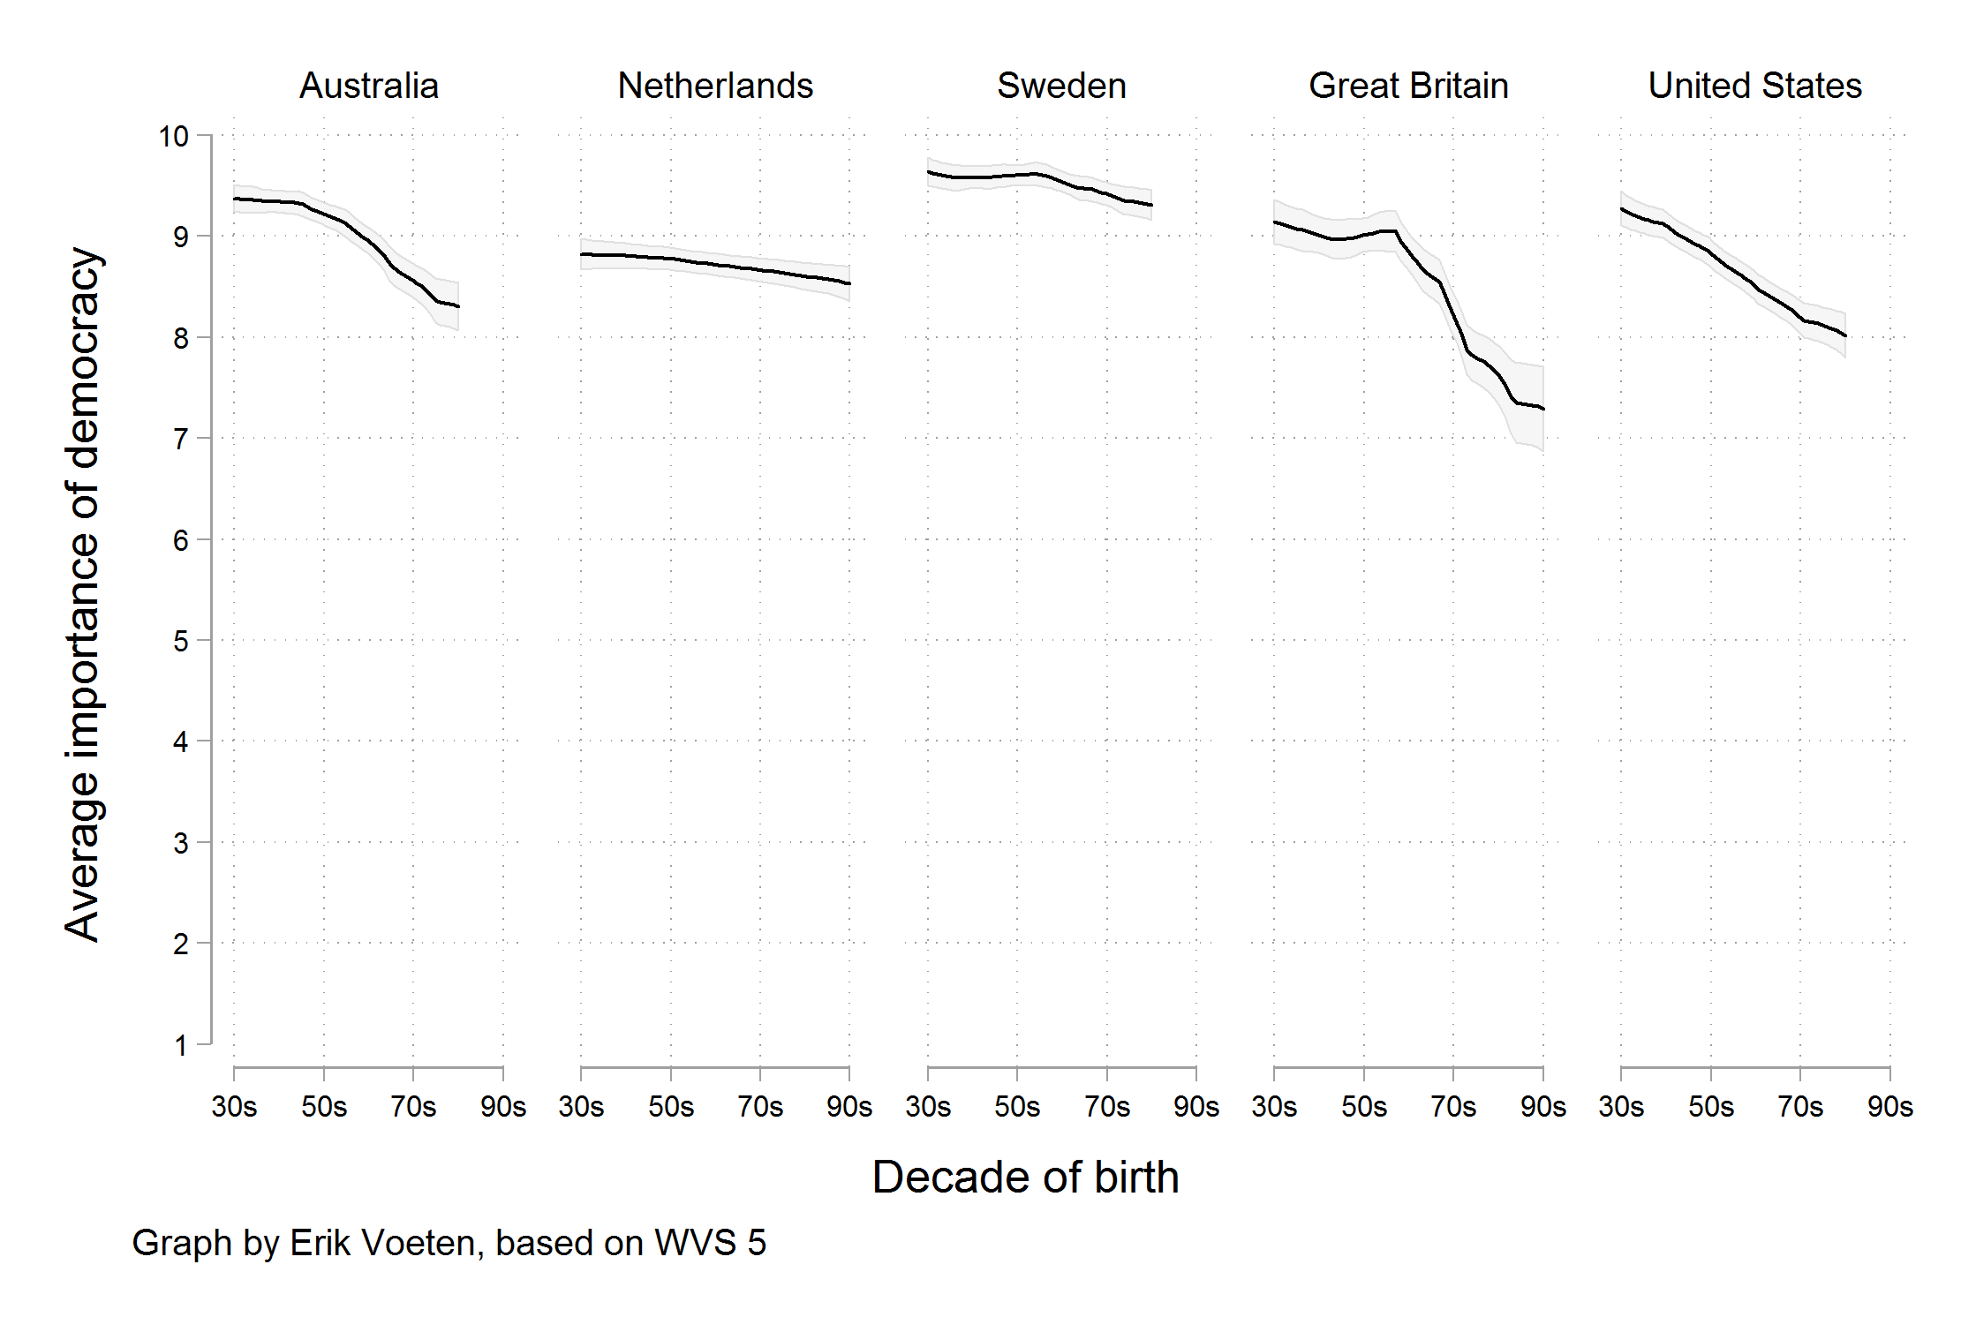
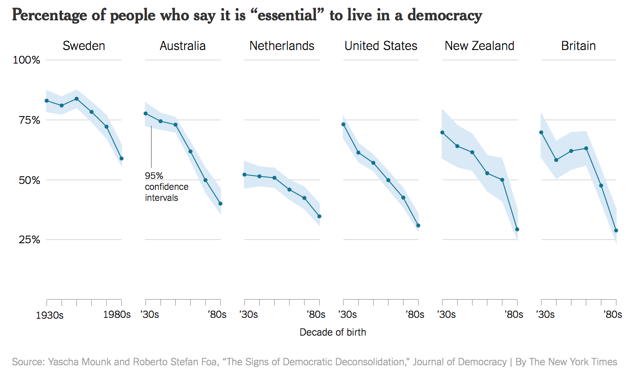
1.2 - What Makes Bad Figures Bad?
Bad Data!
The graph showed the difference across ages of people who had given a score of 10 only
We are now looking at the trend in the average score, rather than the trend for the highest possible answer.

Slide 8
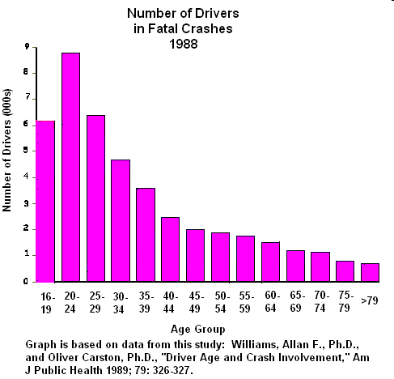
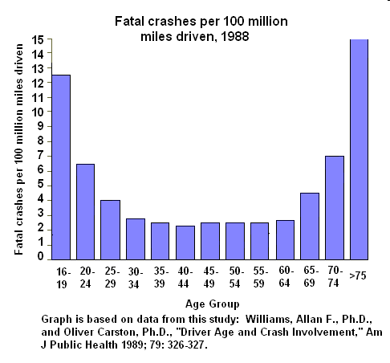
1.2 - What Makes Bad Figures Bad?
Bad Data!
Who are the worst drivers?
Is this graph misleading?
The graph denotes the proportion of each age group of drivers involved in fatal crashes

Slide 9
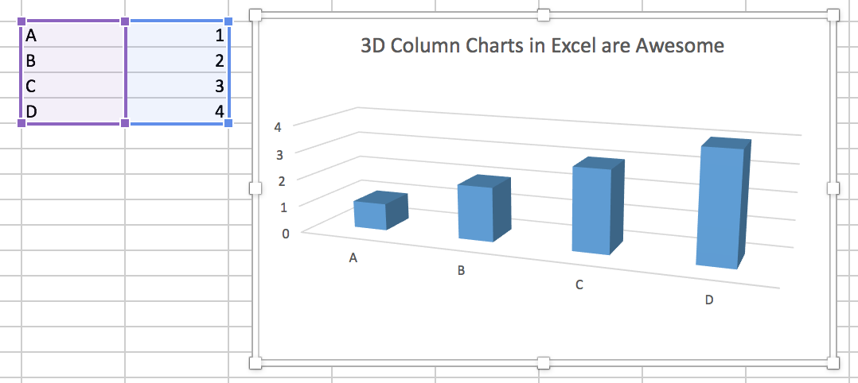
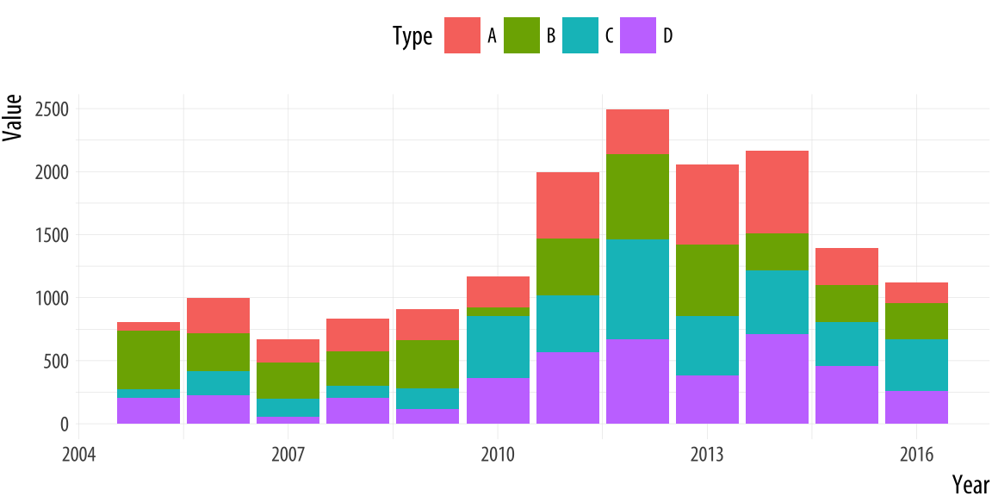
1.2 - What Makes Bad Figures Bad?
Visualizations encode numbers in lines, shapes, and colors.
That means that our interpretation of these encodings is partly conditional on how we perceive geometric shapes and relationships generally.
3D column charts can be scary!
Junk-free plots that remain hard to interpret!

Slide 10
1.2 - What Makes Bad Figures Bad?
Three Problems with Bad Figures
Bad design: The graph we are looking at is in some way tacky, tasteless, or a mixture of ugly or inconsistent design choices.
Substantive: The graph has problems that are due to the data being presented.
A good taste might make things look better, but what we really need is to make better use of the data we have or get new information and plot that instead.
Perceptual: In these cases, even with good taste and good data, the graph will be confusing or misleading because of how people perceive and process what they are looking at.

Slide 11
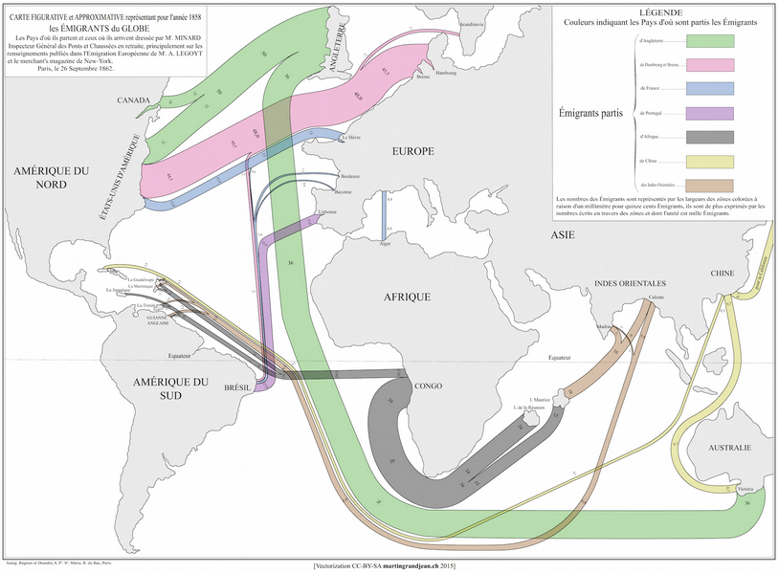
Good Figure!
Minard's 1858 Map of World Migration
The “flow line” – a cartographic presentation method which is modern still today.

Slide 12
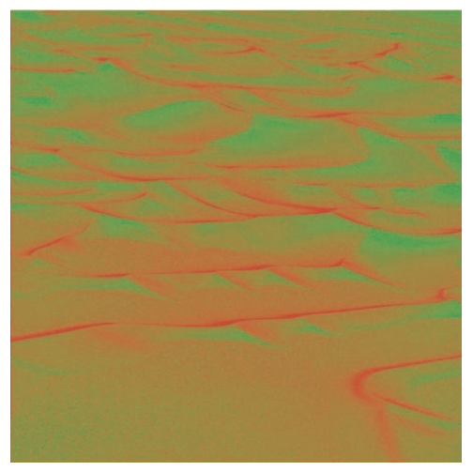

1.3 - Perception and Data Visualization
An effective display must be easily encoded and comprehended by the visual information-processing system.
Looking at pictures of data means looking at lines, shapes, and colors.
Powerful channels for picking out visual elements of interest:
Edges,
Contrasts,
Colors
“Color” is a powerful channel for picking out visual elements of interest.
Figure 1.16: Edge contrasts in monochrome and color

Slide 13
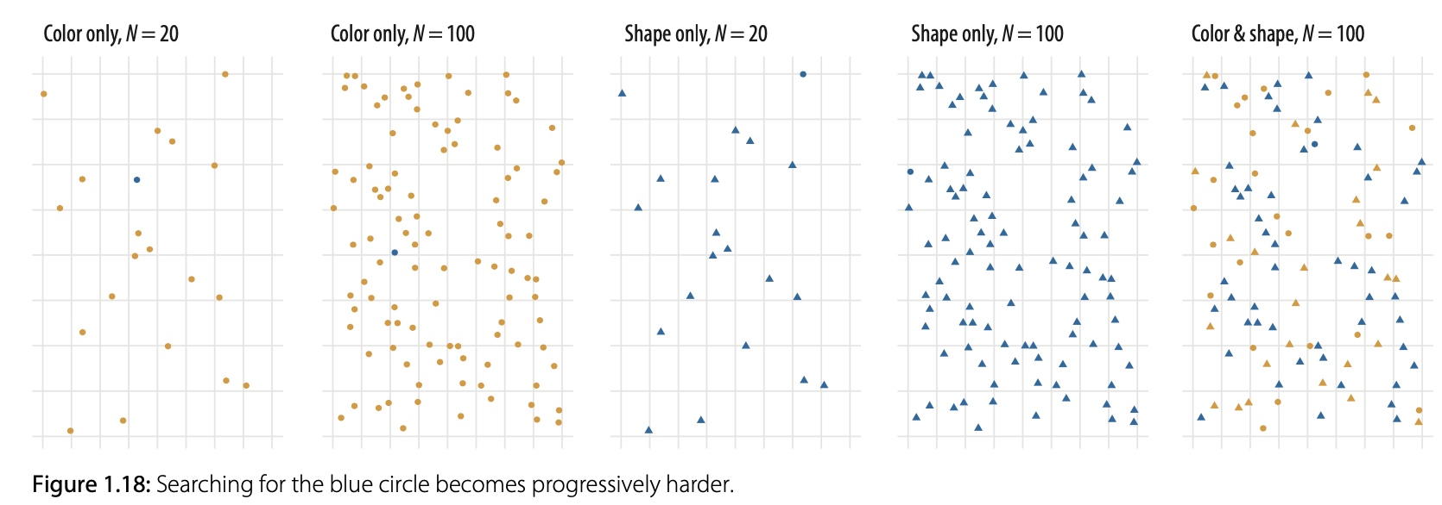
1.3 - Perception and Data Visualization
When choosing color schemes, we will want mappings from data to color that are not just numerically but also perceptually uniform.
Shape and color are two distinct channels that can be used to encode information visually.
Pop-out on the color channel is stronger than it is on the shape channel.

Slide 14
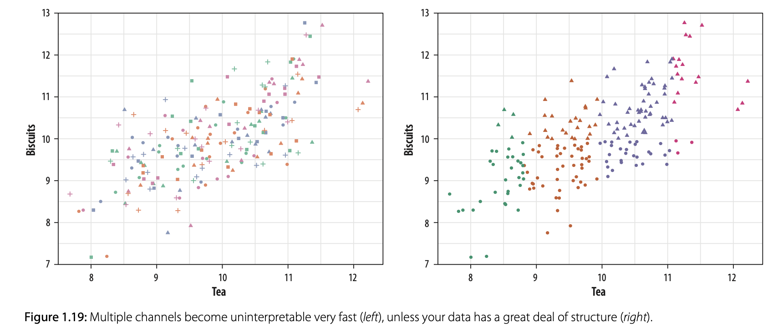
1.3 - Perception and Data Visualization
Even if a software allows us to choose different channels, we should think carefully before representing different variables and their values by shape, color, and position all at once.

Slide 15
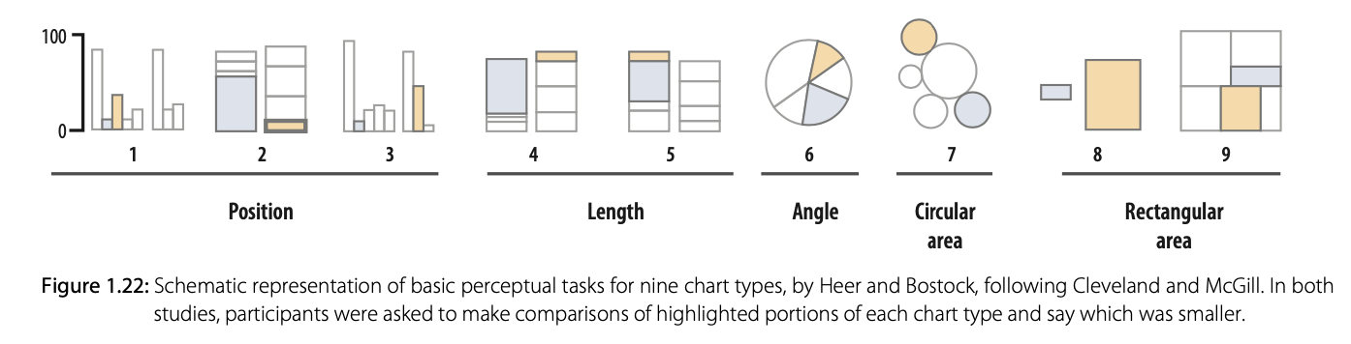
1.4 - Visual Tasks and Decoding Graphs
Different types of graphs require different bits of information to be able to interpret them.
For example, the information you need to figure out what a “Scatter” plot is saying is different than what you need to figure out a pie chart.

Slide 16
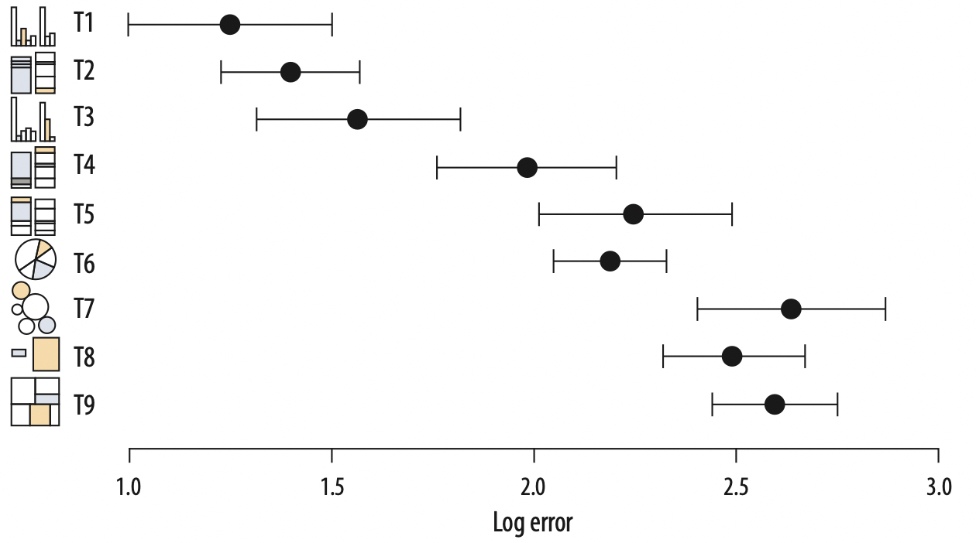
1.4 - Visual Tasks and Decoding Graphs
The overall pattern of results seems clear, with performance worsening substantially as we move away from comparison on
a common scale to
length-based comparisons to
angles and finally
areas.

Slide 17
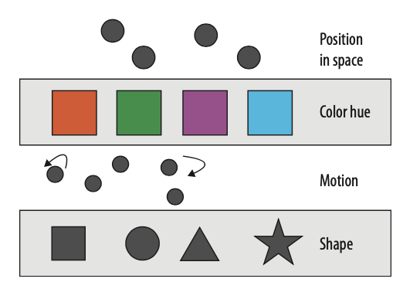
1.5 - Channels for Representing Data
Channels: Graphical elements represent our data in ways that we can see.
Different sorts of variables and attributes can be represented more or less well by different kinds of visual marks or representations, such as points, lines, shapes, and colors.
Our task is to come up with methods that encode or map variables in the right way.
More to less effective.
Figure 1.25: Channels for mapping unordered categorical data

Slide 18
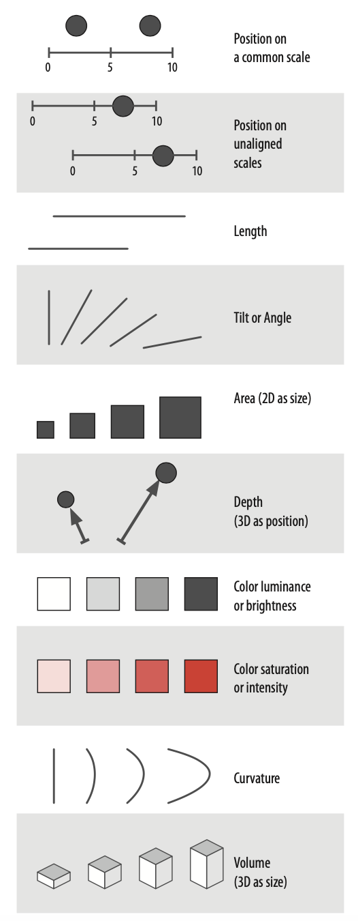
1.5 - Channels for Representing Data
Figure 1.24: Channels for mapping ordered data (continuous or other quantitative measures).
More to less effective.
More to less effective.
More to less effective.

Slide 19
1.6 - Problems of Honesty and Good Judgment
Every decision in the creation of a data visualization needs to be considered carefully.
It is about how to make sure you are conveying your argument faithfully when designing charts and graphs.
There’s one common choice that serves as a case study for the complexities of honest visualization: Whether to truncate the y-axis of a graph by starting at an arbitrary number.

Slide 20
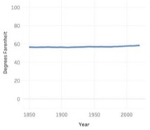
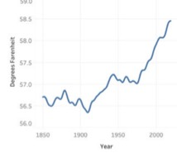
1.6 - Problems of Honesty and Good Judgment
Whether to truncate the y-axis of a graph by starting at an arbitrary number.
For some problems, it might be misleading not to truncate the y-axis.
For example: Climate-change chart:
In a controversial climate-change chart tweeted out by the National Review, the trend of a warming climate was obscured by starting the y-axis at 0 degrees Fahrenheit.
Here, the zero baseline hides the important pattern so strongly that it may be considered dishonest.

Slide 21

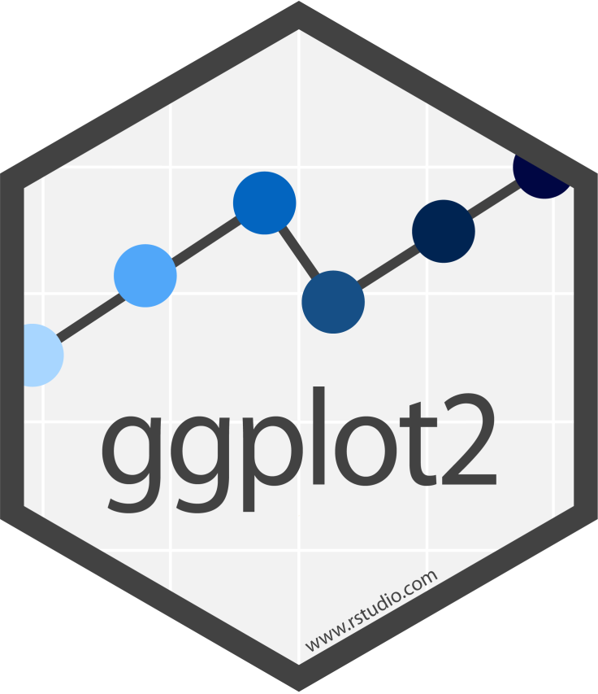
1.7 - Think Clearly about Graphs
The goal is to draw effective graphs in an honest and reproducible way.
A real strength of ggplot2 package in R is implementing a “grammar of graphics”.
ggplot2 is a system for declaratively creating graphics, based on The Grammar of Graphics. You provide the data, tell ggplot2 how to map variables to aesthetics, and what graphical primitives to use, and it takes care of the details.
ggplot2 is now over 10 years old and is used by hundreds of thousands of people to make millions of plots.

Slide 22
Summary
Illustrations like Anscombe’s quartet demonstrate why it is worth looking at data.
Bad taste, chart junk, bad data, bad perception, etc. can make a graph a “bad figure”.
Our task is to come up with methods that encode or map variables in the right way by selecting appropriate channels.
A designers need to ask: What is your honest argument, and who is your audience? Your design should lead that viewer to see that argument.

